Slide 1
Starting your game design Advanced Game Design & Development
Danny Jugan

Slide 2
Games in a 3d world
Certain game genres are better suited for 3D environments.
For your course project, you aren’t required to make an adventure or RPG, but you should choose a game that utilizes the benefits that come with having a 3D environment.
Your game should not simply be a 2D game in a 3D environment.

Slide 3
Where do I start
So you have an idea for a game… or maybe you don’t…
What are the first things that need to be considered when designing a game?
Genre (Adventure, Sports, etc.)
Style (Medieval, Futuristic, Modern, etc.)
Core Mechanics (What is the player doing?)
Fun Features (What will keep the player playing?)
For now, jot down your ideas. You will formalize them later in your Game Design Document (GDD).

Slide 4
The Adventure genre
There is some subjectivity and differing of opining with how games are categorized. For the purpose of this class, we’ll use a broad view of what is label as an Adventure Game.
The Adventure Genre spans across a wide variety of games.
RPGs, Puzzle Games, Stealth Games, etc.
Any game where you can explore and/or interact with an environment that isn’t entirely visible at once.

Slide 5
Your project
While we will discuss game design principles that are universally applicable, most will be directly related/specific to adventure-type games.
Again - your project does not have to be an adventure game, but it must utilize a 3D environment.
We will discuss the specific requirements for your project later.

Slide 6
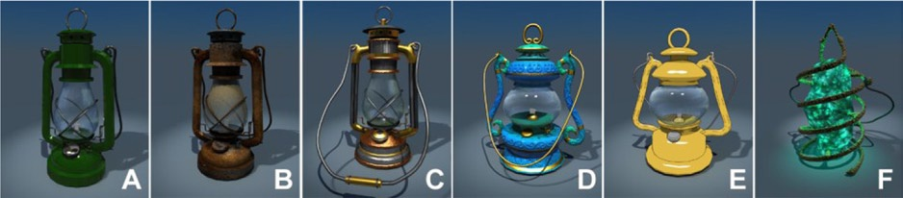
Style
Once you select your genre, you’ll need to decide on a style.
Let’s say you wanted to create an exploration game that will utilize lanterns. What style to use?
How many different RPG styles can you name?

Slide 7
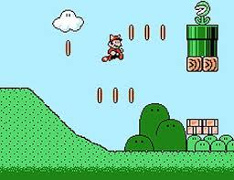
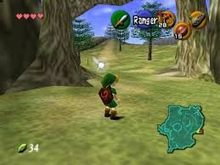
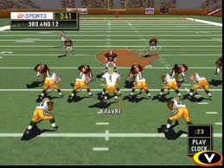
Core mechanics
The core mechanics of a game are the tasks that the player will continually do in order to succeed.
What are the core mechanics of these games?
Mario?
Zelda?
Madden?

Slide 8
Fun features
Here’s the tough part…
You’ve established what your game will look like and what the player will be doing, but why would they want to play your game?
This begs the all-important (and much debated) game design question: What makes games fun?
There are certainly some generic principles to fun, but there are also genre-specific factors to explore.

Slide 9
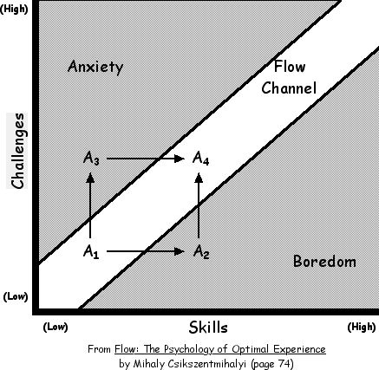
Generic Fun features
There must be a balance between the skill of the player and the challenge level of the game.
Too easy = boredom
Too hard = frustration
A game’s difficulty should
match a player’s skill level.

Slide 10

Generic Fun features
What are other generic features of games that make them fun?
Have you ever played a game that had a feature/mechanic that made you want to turn the game off?

Slide 11

Adventure specific fun features
Suspension of Consequences
Intellectual Stimulus
Visual Engagement
Storyline
Collecting stuff
New experiences

Slide 12
A couple of tips
Keep it simple. More is not always better.
Don’t bite off more than you can chew (i.e., RPGs)
Focus first on the mechanics and features that will make the game fun.
Plan your game in tiers so that you don’t waste your time with extra stuff and get caught with scope creep.
Write everything down – even if it’s messy.

Slide 13
Game Design document (GDD)
GDD Outline and examples are available on Moodle.

